Slide 1

Project on credit bankruptcy
-Naga Asritha Narra

Slide 2
INTRODUCTION
In this project we have used five different models in order to calculate the accuracy and recall which helped to yield Benefit of model.
We have used Credit data
The five different models are:
Logistic Model
Lda Model(Latent Dirichlet Allocation )
Qda Model(Quadratic Discriminant Analysis)
Regression Trees
Knn(K-nearest neighbour)

Slide 3
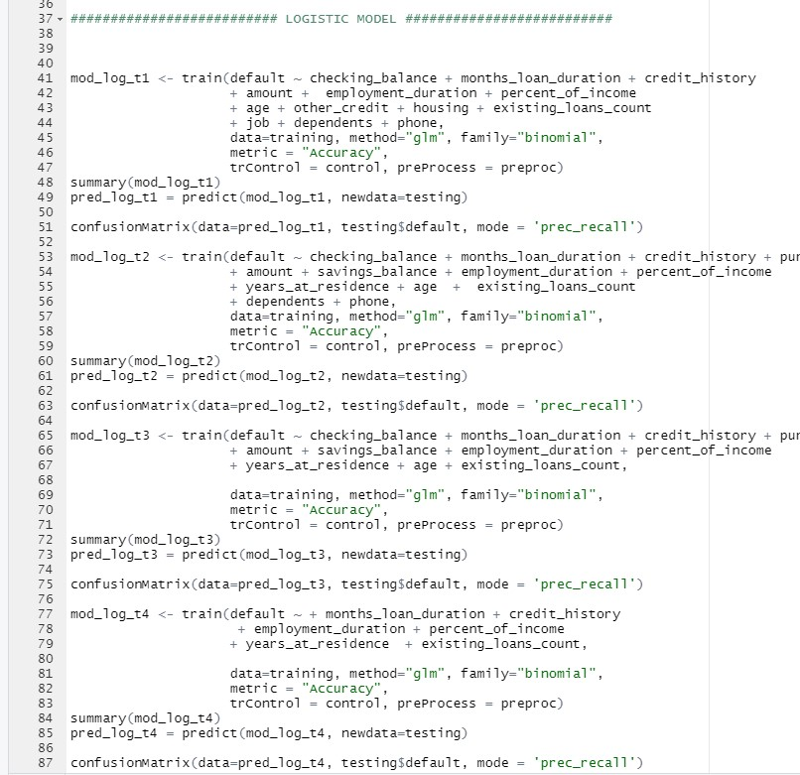
MODEL -1 (LOGISTIC MODEL)
I have tested and built models deleting the insignificant variables(which din’t had stars).
In the logistic model , the high accuracy and recall is 78% and 92% respectively. which yielded benefit of model as 39M
This is the code for the logistic model

Slide 4
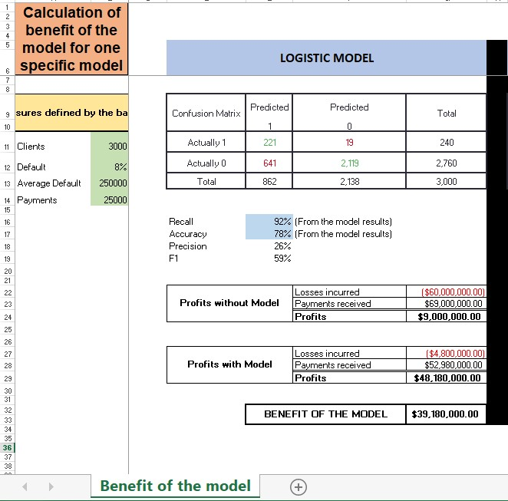
To understand and compute Benefit of the model, I have chose clients as 3000 , default value as 8%, Average default as 250000 and payments as 25000.
The result of the code got recall of 92%, accuracy 78%, precision 26% and F1 of 59%.
Profits obtained without model are 9M.
Profits obtained with Logistic model are 48 M.
Benefit of the model is calculated by subtracting profits with model minus profits without model.
Benefit of the model =$ 39,180,000

Slide 5
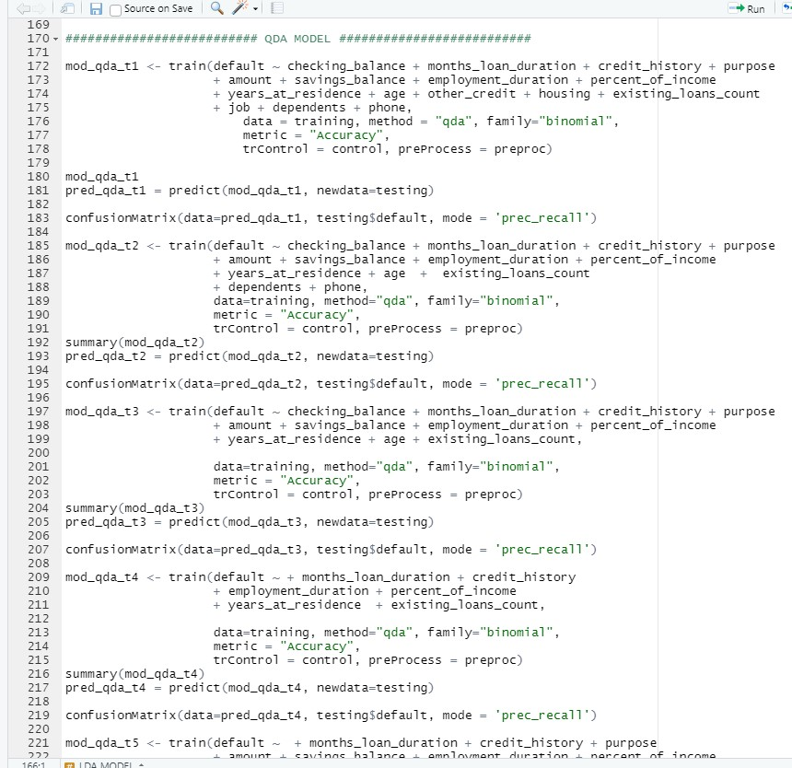
MODEL -2 (QDA MODEL)
I have tested and built models deleting the insignificant variables(which din’t had stars).
In the Qda model , the high accuracy and recall is 72% and 88% respectively. which yielded benefit of model as 32M
This is the code for the Qda model

Slide 6
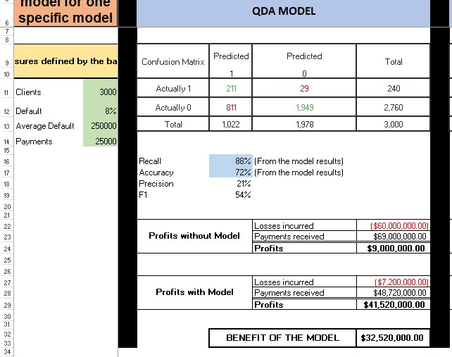
To understand and compute Benefit of the model, I have chose clients as 3000 , default value as 8%, Average default as 250000 and payments as 25000.
The result of the code got recall of 88%, accuracy 72%, precision 21% and F1 of 54%.
Profits obtained without model are 9M.
Profits obtained with Qda model are 41 M.
Benefit of the model is calculated by subtracting profits with model minus profits without model.
Benefit of the model =$ 32,520,000

Slide 7
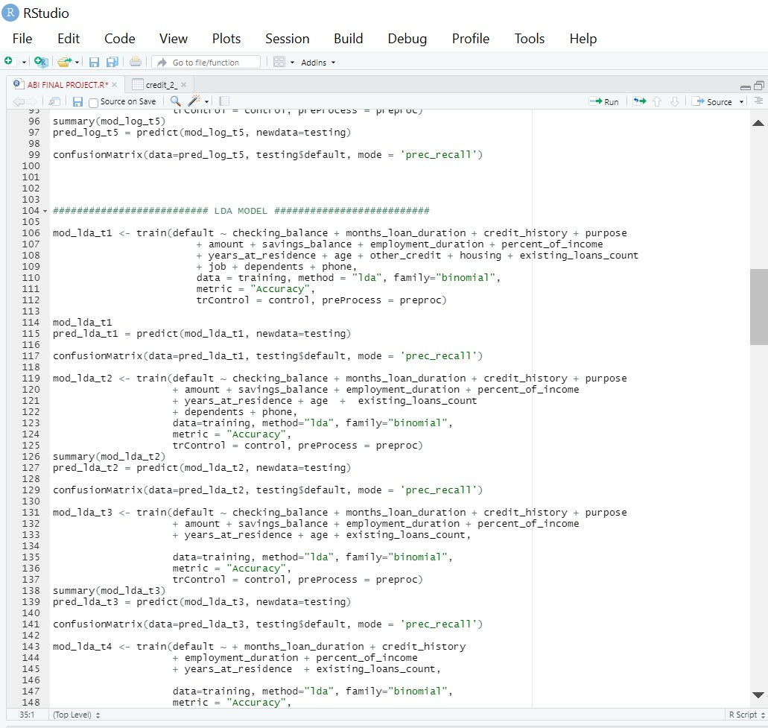
MODEL -3 (LDA MODEL)
I have tested and built models deleting the insignificant variables(which din’t had stars).
In the Lda model , the high accuracy and recall is 78% and 92% respectively. which yielded benefit of model as 39M
This is the code for the Lda model

Slide 8
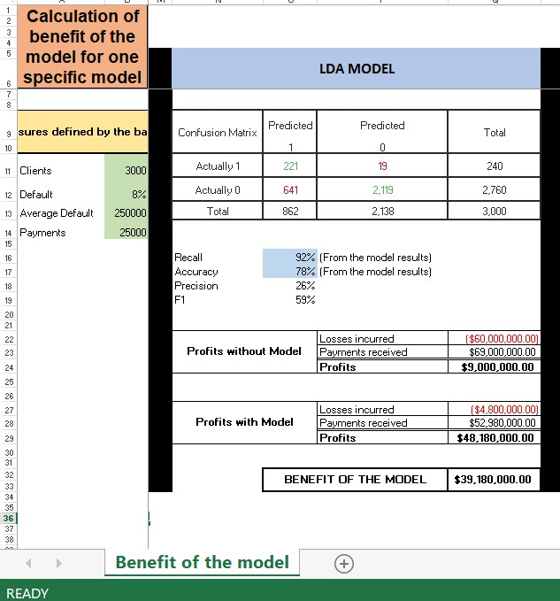
To understand and compute Benefit of the model, I have chose clients as 3000 , default value as 8%, Average default as 250000 and payments as 25000.
The result of the code got recall of 92%, accuracy 78%, precision 26% and F1 of 59%.
Profits obtained without model are 9M.
Profits obtained with Lda model are 48 M.
Benefit of the model is calculated by subtracting profits with model minus profits without model.
Benefit of the model =$ 39,180,000

Slide 9
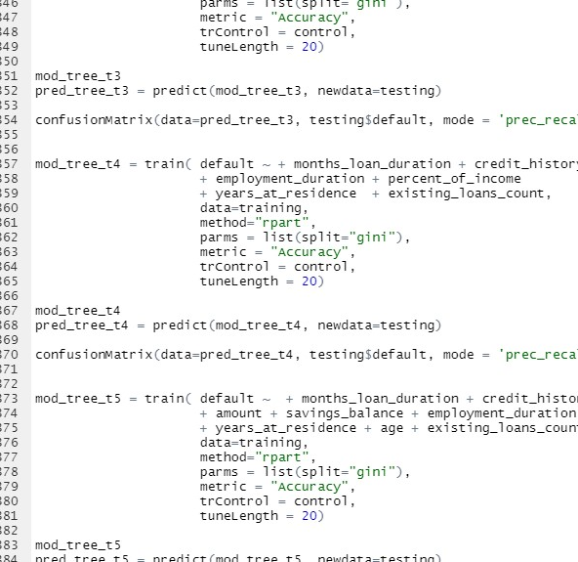
MODEL -4(REGRESSION TREE MODEL)
I have tested and built models deleting the insignificant variables(which din’t had stars).
In the Regression tree model , the high accuracy and recall is 72% and 90% respectively. which yielded benefit of model as 33M.
This is the code for the Regression tree model.

Slide 10
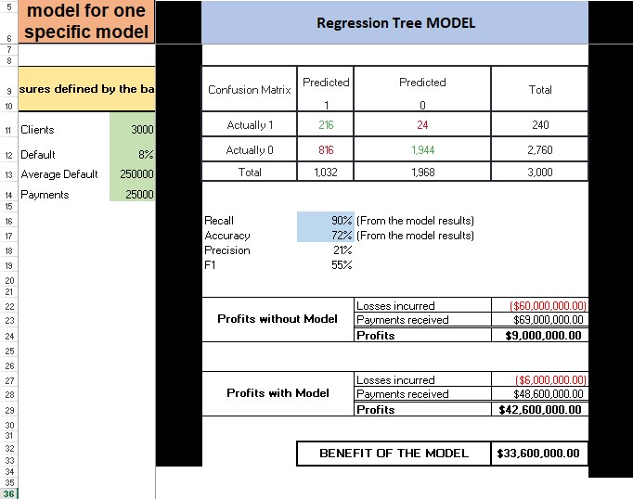
To understand and compute Benefit of the model, I have chose clients as 3000 , default value as 8%, Average default as 250000 and payments as 25000.
The result of the code got recall of 90%, accuracy 72%, precision 21% and F1 of 55%.
Profits obtained without model are 9M.
Profits obtained with Regression tree model are 42 M.
Benefit of the model is calculated by subtracting profits with model minus profits without model.
Benefit of the model =$ 33,600,000

Slide 11
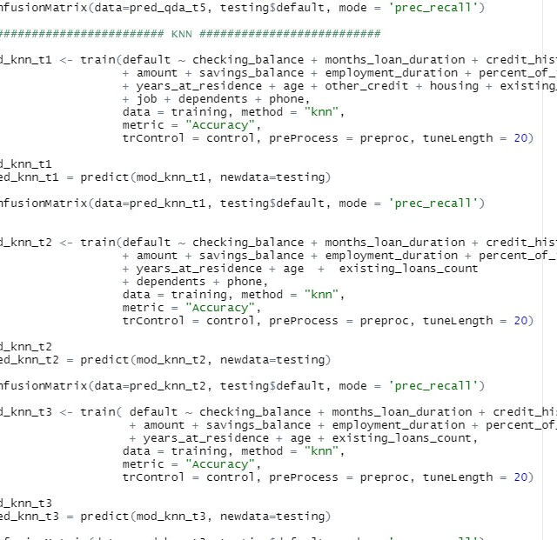
MODEL -5(KNN)
I have tested and built models deleting the insignificant variables(which din’t had stars).
In the Knn model , the high accuracy and recall is 76% and 94% respectively. which yielded benefit of model as 38M.
This is the code for the Knn model.

Slide 12
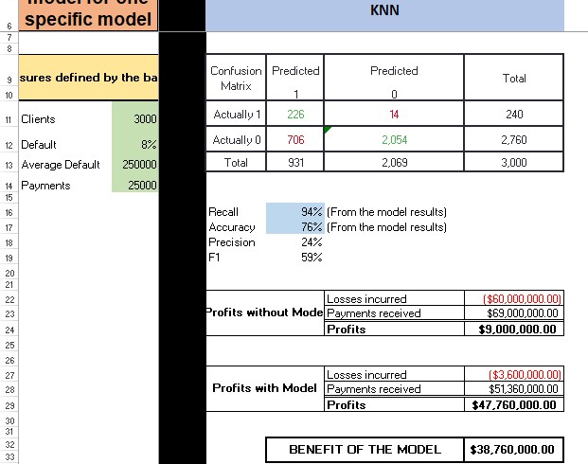
To understand and compute Benefit of the model, I have chose clients as 3000 , default value as 8%, Average default as 250000 and payments as 25000.
The result of the code got recall of 94%, accuracy 76%, precision 24% and F1 of 59%.
Profits obtained without model are 9M.
Profits obtained with Knn model are 47 M.
Benefit of the model is calculated by subtracting profits with model minus profits without model.
Benefit of the model =$ 38,760,000

Slide 13
CONCLUSION
According to the previous observations , we have got higher benefit of model for logistic model.
With Accuracy of 78% , recall 92% ,precision 26% and F1 59%.
Among all of the models, I came to a conclusion that logistic model has the high benefit of model and is the best model among the rest .

